Slide 1
Using eMR2 to improve catheter practice in adult acute care settings
REDUCING CATHETER ASSOCIATED URINARY TRACT INFECTIONS
CLINICAL EXCELLENCE
COMMISSION
2015

Slide 2
MODULE 3
Automatically triggering a medical review of the catheter
Notes:
Educator notes:
This is an automatic function that has been built into this release of eMR.
This automatically triggered medical order is an electronic safeguard that has been put in place to ensure that patients do not have catheters in situ for unnecessarily prolonged periods of time. Research shows that the microbial load of the catheter increases the longer the catheter remains in situ. Thus the risk of infection increases the longer the catheter is in place.
In acute settings, a catheter review should be done at least once in every 24 hour period for the duration of catheterisation.
References:
1. Donlan, R.M., Biofilms and device-associated infections. Emerging Infectious Diseases, 2001. 7(2): p. 277-281.
2. Saint, S. and C. Chenoweth, Biofilms and catheter-associated urinary tract infections. Infectious Diseases Clinics of North America, 2003. 17(2): p. 411-432.

Slide 3
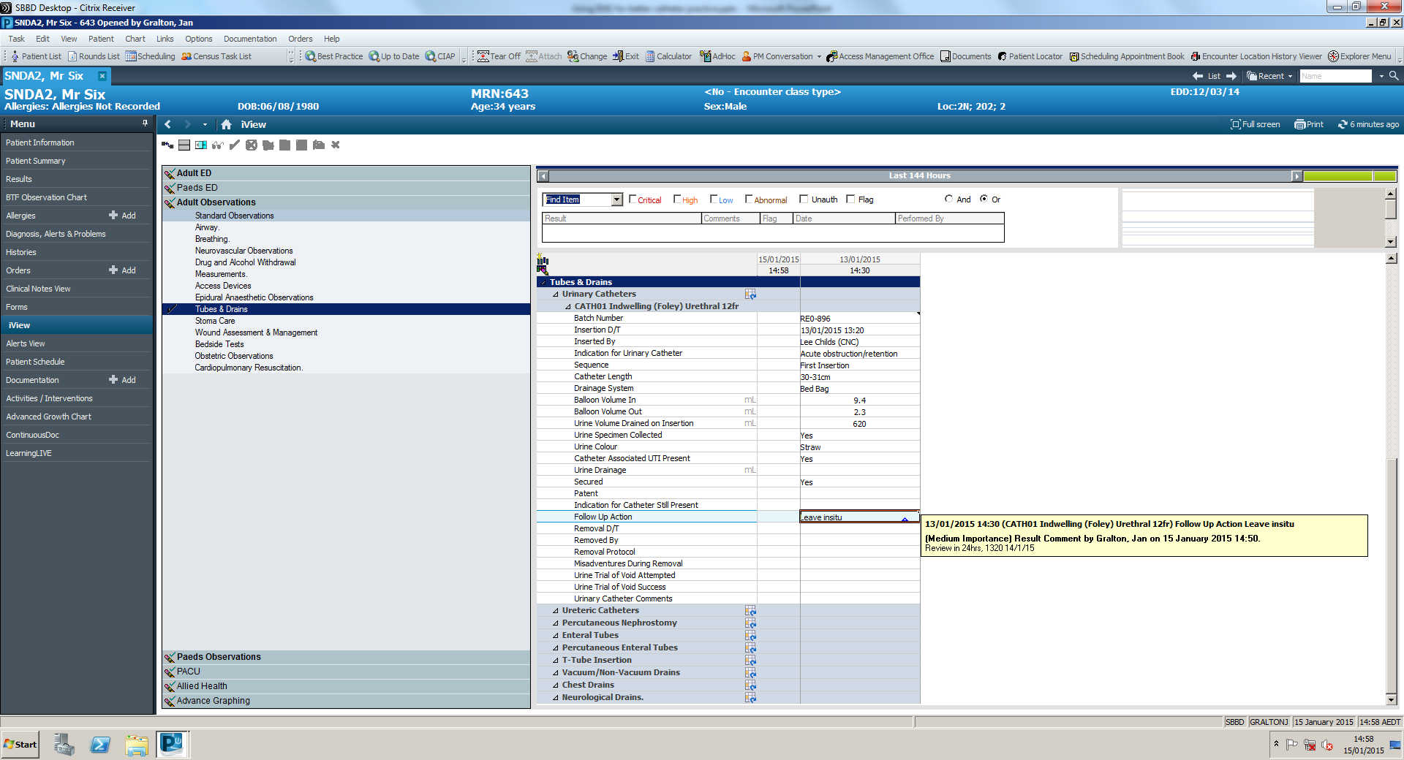
Automatically triggering medical reviews
In this example, a catheter was inserted on 13/1/2015 at 1320.
After >48 hours in situ, no other observations have been entered.
Notes:
Educator notes:
Note that the follow up action instructs for a catheter review at 24hrs.
Note that no catheter review or catheter removal observations have been entered after the initial catheter insertion.
If the medical record was being audited, it would appear that the catheter has gone unchecked for over 48 hours.

Slide 4
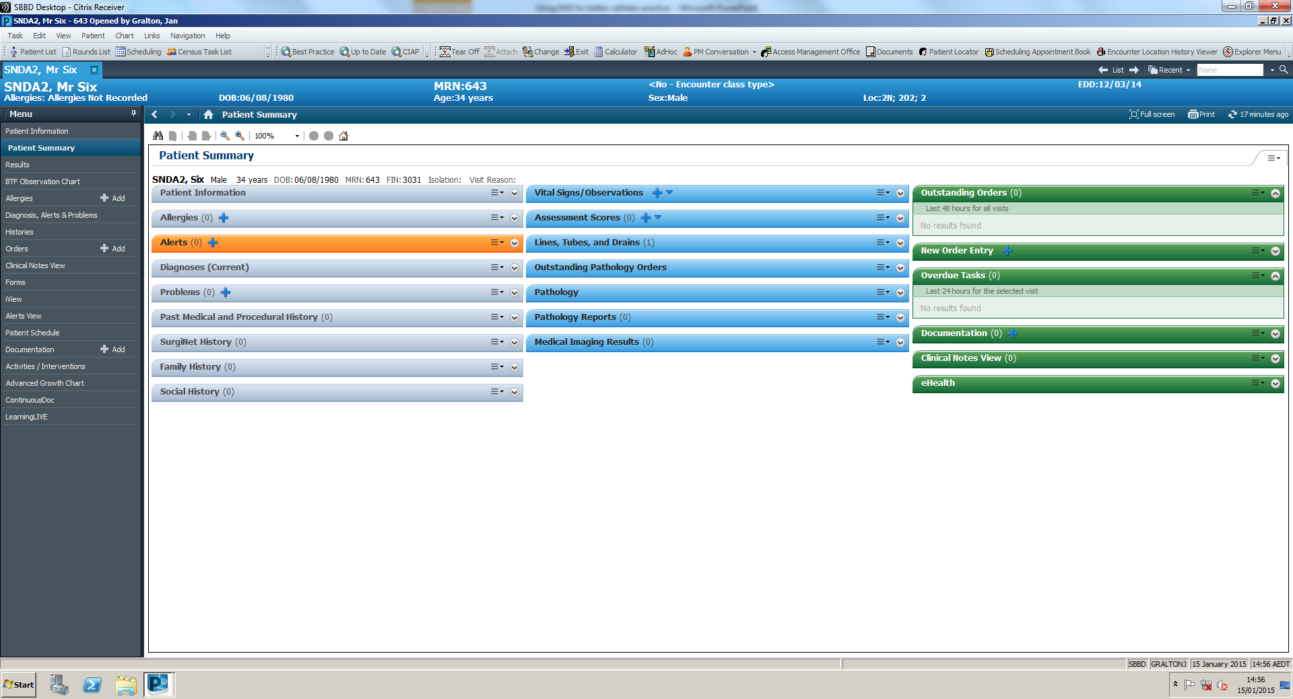
Automatically triggering medical reviews
After 48 hours in situ, no other observations have been entered.
Nothing new appears on the patient summary screen either.
Notes:
Educator notes:
Point out that at this point in time (over 48 hours after insertion) no orders are listed under Outstanding Orders or Overdue Tasks (green tabs).

Slide 5
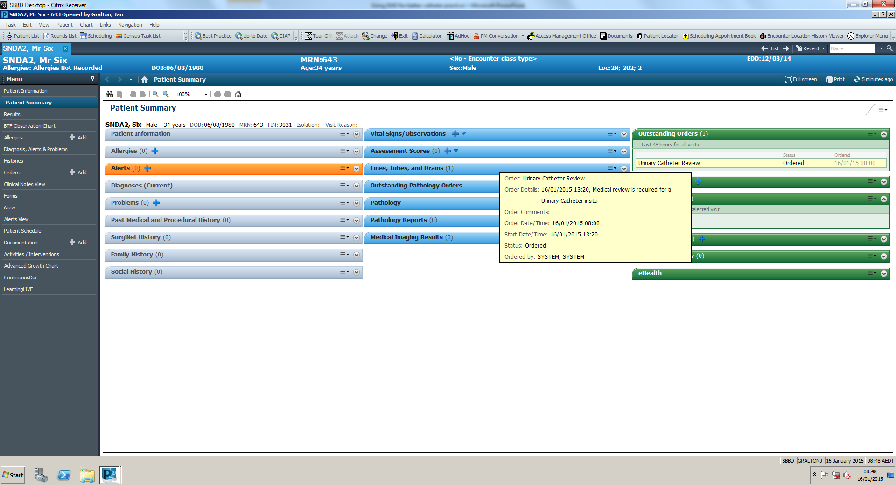
Automatically triggering medical reviews
After 64 hours in situ, a review order will automatically appear on this screen.
Notes:
Educator notes:
If we log back into the eMR at >64 hrs post insertion, we can see that the patient summary screen has changed.
Look at the Outstanding Orders tab - a medical review for an catheter review automatically has been posted by the eMR.
Yellow box will appear if you hover over ‘Urinary Catheter Review’ in the Outstanding Orders list.
If it is not documented that the catheter is not removed within the first 72hrs since insertion, eMR will automatically post this order at 64hrs after the catheter has been inserted. This order will first be listed under Outstanding Orders in the patient summary to remind all users logging into this patient’s record that the catheter needs to be attended to.
The order will stay as an Outstanding Order in the patient summary for the next 48 hours, which will be the equivalent of 112 hours after the catheter was first inserted.
This alerting feature is a safeguard to ensure that a review of the catheter has been done and documented. It is important the catheters are reviewed at least once in each 24 hour period for patients receiving care in the acute setting.

Slide 6
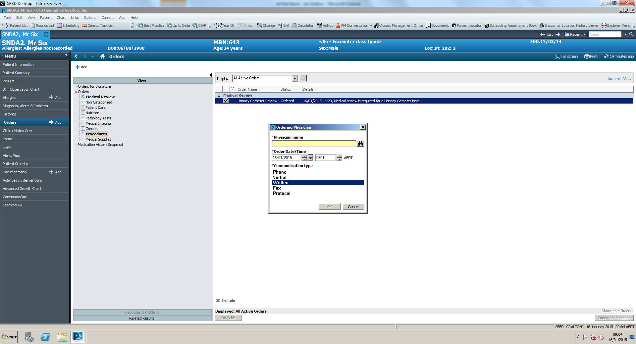
Automatically triggering medical reviews
Notes:
Educator notes:
To further view the Outstanding Order, click Orders in the side menu.
The Urinary Catheter Review order is automatically listed under Medical Reviews.
Click the tickbox to assign the medical review order to a particular medical officer’s task list.
The Urinary Catheter Review Order will no longer be visible once the medical officer has documented that the review was completed and/or catheter removal has been documented in the eMR.

Slide 7
Thank you
For further information:
cec-hai@health.nsw.gov.au
www.cec.health.nsw.gov.au

