Slide 1
Tall Man Lettering Reducing Mix Ups
<Hospital Name>
<Presenter’s Name>
<DATE>
LHD LOGO

Slide 2
Medicine name confusion
Many medicine names look like or sound like other medicine names
Azithromycin Azathioprine
Humalog Humulin
Lamictal Largactil
Lamivudine Lamotrigine
Trimeprazine Trimethoprim
Zoloft Zocor

Slide 3
Pattern matching
I cdnuolt blveiee taht I cluod aulaclty uesdnatnrd waht I was rdanieg. The phaonmneal pweor of the hmuan mnid! Aoccdrnig to a rscheearch at Cmabrigde Uinervtisy, it deosn't mttaer inwaht oredr the ltteers in a wrod are, the olny iprmoatnt tihng is taht the frist and lsat ltteer be in the rghit pclae. The rset can be a taotl mses and you can sitll raed it wouthit a porbelm. Tihs is bcuseae the huamn mnid deos not raed ervey lteter by istlef, but the wrod as a wlohe. Amzanig huh? Yaeh, and I awlyas thought slpeling was ipmorantt

Slide 4
Reading
THESHAPEANDTHEPATTERNSOFTHEWORDSAREIMPORTANTINREADING
THE SHAPE AND PATTERNS OF THE WORDS ARE IMPORTANT IN READING
TheSHAPEandPATTERNSoftheWORDSareIMPORTANTinREADING
The shape and patterns of the words are important in reading
Short WORDS that ARE well known, are perceived (READ) as images

Slide 5
Name confusion errors
Thousands of medication errors each year are due to look-a-like, sound-a-like names
Some cause significant patient harm
Severity depends on range of factors
drug, class, effect, allergies

Slide 6
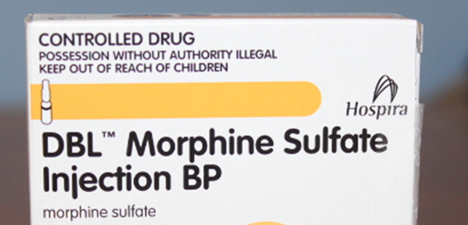
Example 1
HYDROmorphone administered instead of morphine
patient died

Slide 7
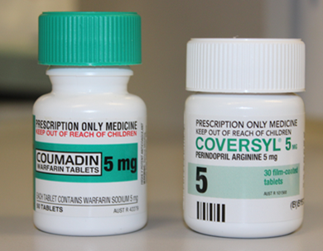
Example 2
coUMADIN (warfarin -anticoagulant)
dispensed instead of
coVERSYL (perindopril - antihypertensive)
Patient admitted to hospital

Slide 8
Preventing Look-a-Like Sound-a-Like (LASA) errors
Multifaceted approach is needed involving all aspects of the medication process from manufacturing, prescribing, dispensing to administration
Preventing names being registered that are confusing
Not purchasing medicines with confusing names
Electronic screening of LASA names
Barcode scanning
Separating storage
Tall Man Lettering
cHLORPROMAZIne
lanTUs
ERYthromycin
CARBAMazepine

Slide 9
Tall Man Lettering
Uses a combination of lower and upper case letters to highlight the differences between look-alike, sound-alike medicine names
amIODAROne | amLODIPine
coUMADIN | coVERSYL
nEURONtin | nOROXin
valAciclovir | vaIGANciclovir

Slide 10
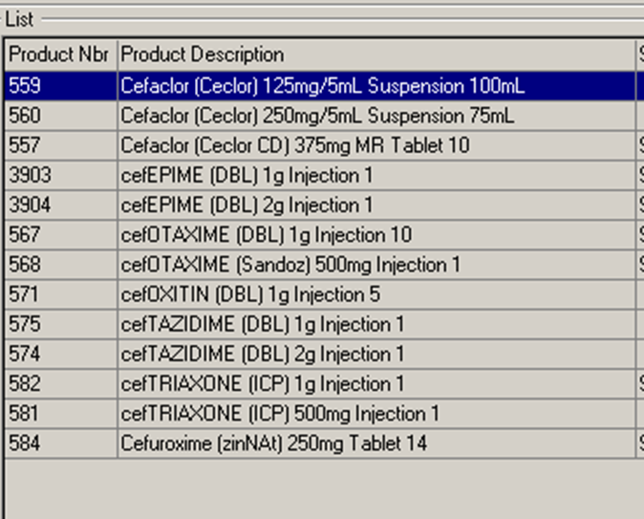
Tall Man Lettering in February 2015
Will be applied to:
Inpatient medicine labels
Shelf medicine labelling in ward imprest areas
Shelf medicine labelling in dispensaries
On-screen display of medicines during dispensing

Slide 11
Which medicines?
Only confusable medicines with the greatest potential to cause harm
Listed on the ACSQHC National list of Australian medicines names with Tall Man applied
Only for use within the inpatient setting
Not required for handwriting
Not required for printed labels intended for patients e.g. discharge or outpatient medicine labels

Slide 12
Your role
Be aware medicines with Tall Man Lettering are often confused
Slow down
Check the medicine name
Report any errors involving confusion with medicine names

Slide 13
Thank you Questions
For further information:
cec-medicationsafety@health.nsw.gov.au
www.cec.health.nsw.gov.au

